Slide 1
VLOOKUP Function and IS Functions
CIS 300: Computer Information Systems
Professor Matt Thatcher
Some of these slides are based on a presentation created by Dale McIntosh

Slide 2
Reminders
Turn in Homework Assignment 2
  BB > Assignments > Homework
  Due: Wed, Feb 3 by 11:30 pm
  Use MS Excel to solve some simple “business problems”
  Turn in MS Excel file to:
    BB > Assignments > Submit Work Here > Homework 2
Lab 3
  BB > Tegrity Classes (Lab 3)
  Please take time to walk through Lab 3 and view my Lab 3 walkthrough on Tegrity
    It is only 36 minutes, and it will help you prepare for Test 2
Start on Homework Assignment 3
  BB > Assignments > Homework
  Due: Mon, Feb 15 by 11:30pm

Slide 3
VLOOKUP Function
Searches for a value in the first (or leftmost) column of a table, and then returns a value in the same row from a column you specify in the table.
Syntax
VLOOKUP(lookup_value,lookup_range,col_num,match_type)
Remarks
Use VLOOKUP when your comparison values are located in a column to the left of the data you want to find
The V in VLOOKUP stands for "Vertical"

Slide 4
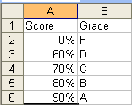
VLOOKUP
(A Common Example)
What grade will a student receive if she has an overall score of 87.50%?
VLOOKUP lets you search for the lookup_value (87.50%) in the leftmost column (1st column) of a table or lookup_range (A2:B6), and then returns a value in the same row from a col_num (2) in the lookup_range
  =VLOOKUP(87.50%,A2:B6,2,TRUE) returns the value B

Slide 5
=VLOOKUP(lookup_value,lookup_range,col_num,match_type) =VLOOKUP(87.50%,A2:B6,2,TRUE)
Lookup_value (e.g., 87.50%)
  the value to be found in the first column of the table
  it can be a value, a cell reference, a formula, or a text string
Lookup_range (e.g., A2:B6)
  the cell range (or table) in which data is looked up
    If match_type is TRUE, the values in the first column of the table must be placed in ascending order: ..., -2, -1, 0, 1, 2, ..., A-Z, FALSE, TRUE; otherwise VLOOKUP may not give the correct value.
    If match_type is FALSE, then the table does not need to be sorted
    You can put the values in ascending order by selecting the table range and choosing Data > Sort > Ascending (by the 1st column)
  the values in the first column of the lookup_range can be text, numbers, or logical values.
  uppercase and lowercase text are equivalent

Slide 6
=VLOOKUP(lookup_value,lookup_range,col_num,match_type) =VLOOKUP(87.50%,A2:B6,2,TRUE)
Col_num (e.g., 2)
  the column number in the lookup_range (or table) from which the matching value must be returned.
  a col_num of 1 returns the value in the first column in the lookup_range
  a col_num of 2 returns the value in the second column in lookup_range
  and so on
If col_num is
  less than 1, then VLOOKUP returns the #VALUE! error value
  greater than the number of columns in the lookup_range (or table), then VLOOKUP returns the #REF! error value

Slide 7
=VLOOKUP(lookup_value,lookup_range,col_num,match_type) =VLOOKUP(87.50%,A2:B6,2,TRUE)
Match_type
  a logical value (i.e., TRUE or FALSE) that specifies whether you want VLOOKUP to find an exact match (FALSE) or an approximate match (TRUE) of the lookup_value in the first column of the lookup_range
  If TRUE or omitted, an approximate match is returned
    In other words, if an exact match is not found, VLOOKUP uses the largest value that is less than or equal to lookup_value
  If FALSE, VLOOKUP will find an exact match
    If one is not found, the #N/A error value is returned
Other Comments
  If lookup_value is smaller than the smallest value in the first column of the lookup_range, then VLOOKUP returns the #N/A error value
  If VLOOKUP can't find the lookup_value, and match_type is FALSE, then VLOOKUP returns the #N/A value

Slide 8
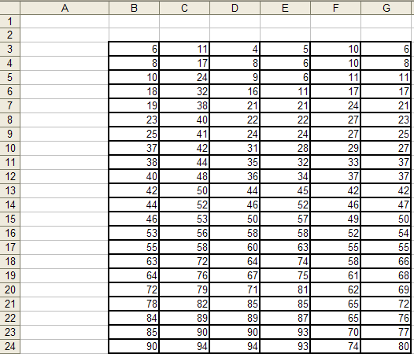
=VLOOKUP(C11*2, $B$8:$G$24, G18/E6, TRUE)
=VLOOKUP(IF(MIN(B6:F18)<>MAX(D3:G5), 38, 83), E11:G22,3)
=VLOOKUP(MAX(B3:G4)*B6/G3, $C$8:$F$20, 3, FALSE)
=VLOOKUP(C3*E3, C8:F20, IF(SUM(B3:B24)>SUM(F3:F24), 2, 4))
=VLOOKUP(LARGE(D10:G17,4), $C$8:$F$20, 5, FALSE)

Slide 9
=VLOOKUP(C11*2, $B$8:$G$24, G18/E6, TRUE)

Slide 10
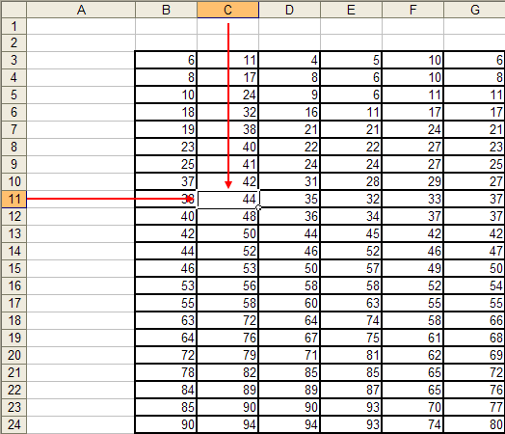
=VLOOKUP(C11*2, $B$8:$G$24, G18/E6, TRUE)
=VLOOKUP(44*2, $B$8:$G$24, G18/E6, TRUE)

Slide 11
=VLOOKUP(C11*2, $B$8:$G$24, G18/E6, TRUE)
=VLOOKUP(44*2, $B$8:$G$24, G18/E6, TRUE)
=VLOOKUP(88, $B$8:$G$24, G18/E6, TRUE)

Slide 12
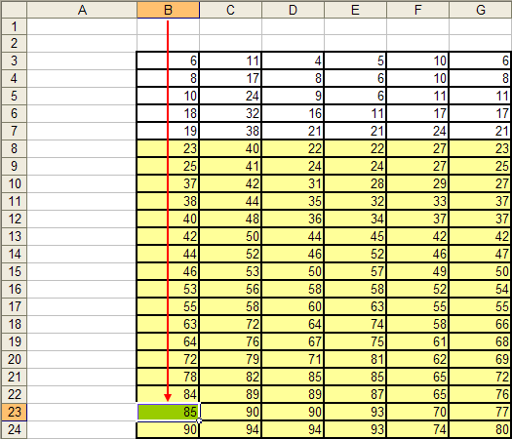
=VLOOKUP(C11*2, $B$8:$G$24, G18/E6, TRUE)
=VLOOKUP(44*2, $B$8:$G$24, G18/E6, TRUE)
=VLOOKUP(88, $B$8:$G$24, G18/E6, TRUE)

Slide 13
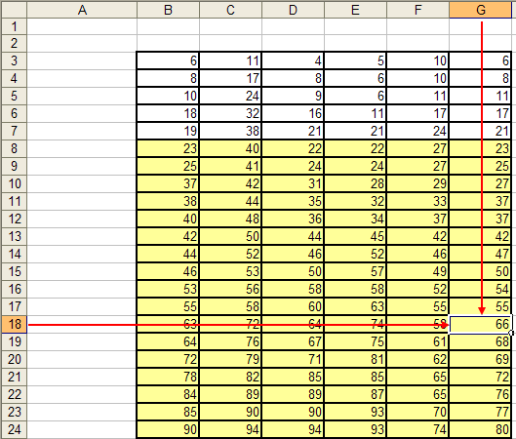
=VLOOKUP(C11*2, $B$8:$G$24, G18/E6, TRUE)
=VLOOKUP(44*2, $B$8:$G$24, G18/E6, TRUE)
=VLOOKUP(88, $B$8:$G$24, G18/E6, TRUE)
=VLOOKUP(88, $B$8:$G$24, 66/E6, TRUE)

Slide 14
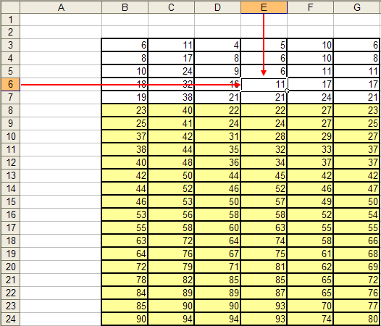
(1) =VLOOKUP(C11*2, $B$8:$G$24, G18/E6, TRUE)
=VLOOKUP(44*2, $B$8:$G$24, G18/E6, TRUE)
=VLOOKUP(88, $B$8:$G$24, G18/E6, TRUE)
=VLOOKUP(88, $B$8:$G$24, 66/E6, TRUE)
=VLOOKUP(88, $B$8:$G$24, 66/11, TRUE)

Slide 15
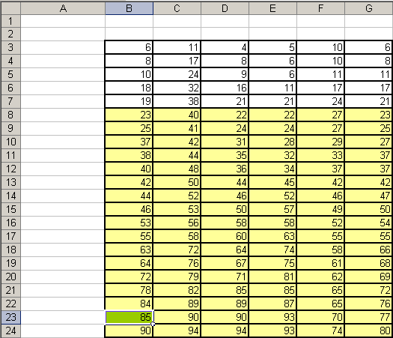
(1) =VLOOKUP(C11*2, $B$8:$G$24, G18/E6, TRUE)
=VLOOKUP(44*2, $B$8:$G$24, G18/E6, TRUE)
=VLOOKUP(88, $B$8:$G$24, G18/E6, TRUE)
=VLOOKUP(88, $B$8:$G$24, 66/E6, TRUE)
=VLOOKUP(88, $B$8:$G$24, 66/11, TRUE)
=VLOOKUP(88, $B$8:$G$24, 6, TRUE)

Slide 16
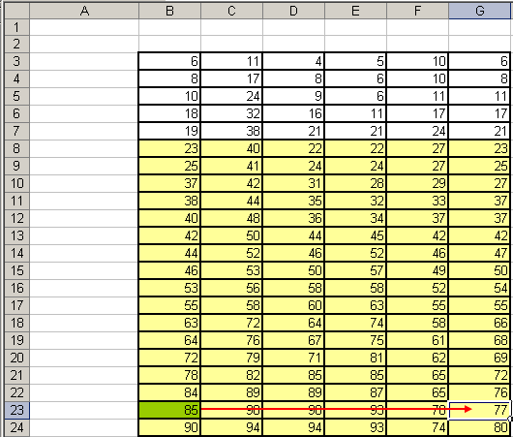
=VLOOKUP(C11*2, $B$8:$G$24, G18/E6, TRUE)
=VLOOKUP(44*2, $B$8:$G$24, G18/E6, TRUE)
=VLOOKUP(88, $B$8:$G$24, G18/E6, TRUE)
=VLOOKUP(88, $B$8:$G$24, 66/E6, TRUE)
=VLOOKUP(88, $B$8:$G$24, 66/11, TRUE)
=VLOOKUP(88, $B$8:$G$24, 6, TRUE)
=77

Slide 17
(2) =VLOOKUP(IF(MIN(B6:F18)<>MAX(D3:G5), 38, 83), E11:G22,3)

Slide 18
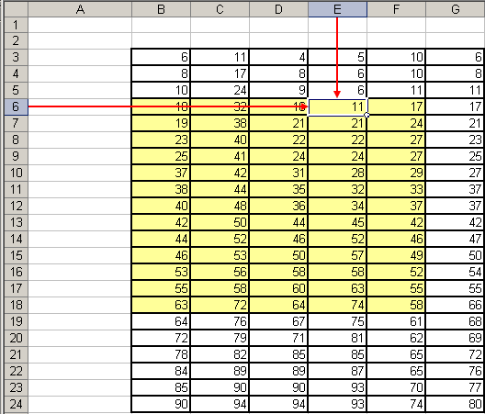
=VLOOKUP(IF(MIN(B6:F18)<>MAX(D3:G5), 38, 83), E11:G22,3)
=VLOOKUP(IF(11<>MAX(D3:G5), 38, 83), E11:G22,3)

Slide 19
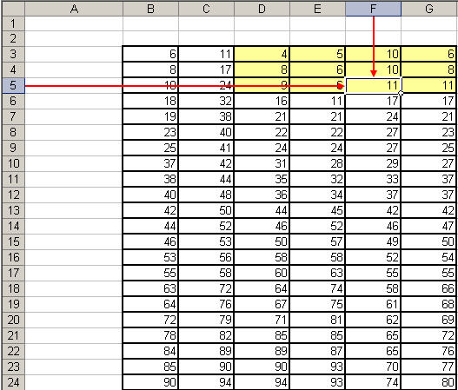
=VLOOKUP(IF(MIN(B6:F18)<>MAX(D3:G5), 38, 83), E11:G22,3)
=VLOOKUP(IF(11<>MAX(D3:G5), 38, 83), E11:G22,3)
=VLOOKUP(IF(11<>11, 38, 83), E11:G22,3)

Slide 20
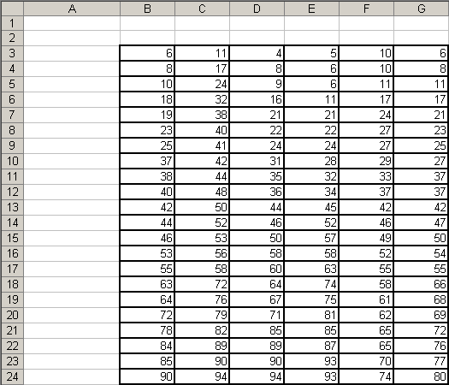
=VLOOKUP(IF(MIN(B6:F18)<>MAX(D3:G5), 38, 83), E11:G22,3)
=VLOOKUP(IF(11<>MAX(D3:G5), 38, 83), E11:G22,3)
=VLOOKUP(IF(11<>11), 38, 83), E11:G22,3)
=VLOOKUP(IF(FALSE, 38, 83), E11:G22,3)

Slide 21
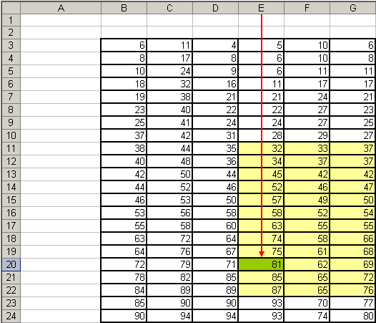
=VLOOKUP(IF(MIN(B6:F18)<>MAX(D3:G5), 38, 83), E11:G22,3)
=VLOOKUP(IF(11<>MAX(D3:G5), 38, 83), E11:G22,3)
=VLOOKUP(IF(11<>11), 38, 83), E11:G22,3)
=VLOOKUP(IF(FALSE, 38, 83), E11:G22,3)
=VLOOKUP(83, E11:G22,3)

Slide 22
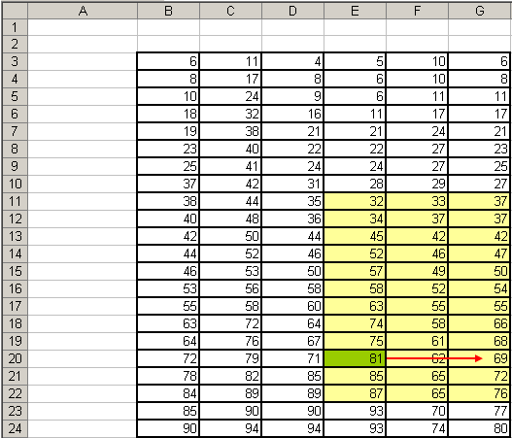
=VLOOKUP(IF(MIN(B6:F18)<>MAX(D3:G5), 38, 83), E11:G22,3)
=VLOOKUP(IF(11<>MAX(D3:G5), 38, 83), E11:G22,3)
=VLOOKUP(IF(11<>11), 38, 83), E11:G22,3)
=VLOOKUP(IF(FALSE, 38, 83), E11:G22,3)
=VLOOKUP(83, E11:G22,3)
=69

Slide 23
(3) =VLOOKUP(MAX(B3:G4)*B6/G3, $C$8:$F$20, 3, FALSE)

Slide 24
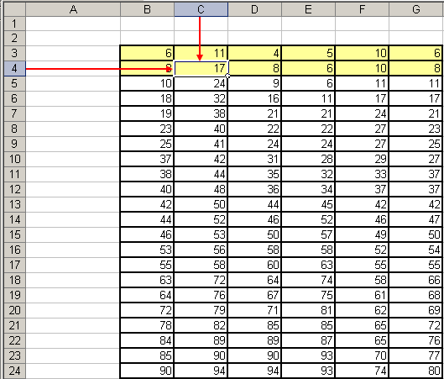
=VLOOKUP(MAX(B3:G4)*B6/G3, $C$8:$F$20, 3, FALSE)
=VLOOKUP(17*B6/G3, $C$8:$F$20, 3, FALSE)

Slide 25
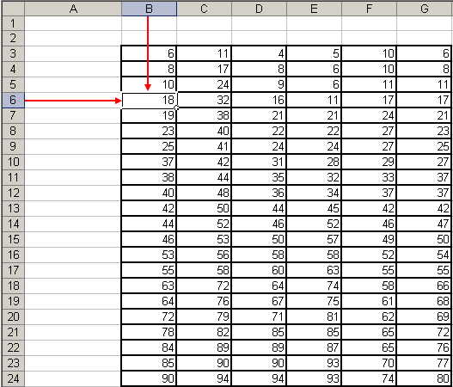
=VLOOKUP(MAX(B3:G4)*B6/G3, $C$8:$F$20, 3, FALSE)
=VLOOKUP(17*B6/G3, $C$8:$F$20, 3, FALSE)
=VLOOKUP(17*18/G3, $C$8:$F$20, 3, FALSE)

Slide 26
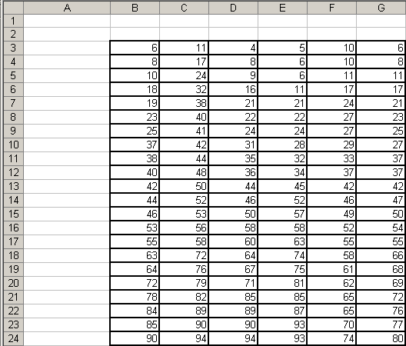
=VLOOKUP(MAX(B3:G4)*B6/G3, $C$8:$F$20, 3, FALSE)
=VLOOKUP(17*B6/G3, $C$8:$F$20, 3, FALSE)
=VLOOKUP(17*18/G3, $C$8:$F$20, 3, FALSE)
=VLOOKUP(306/G3, $C$8:$F$20, 3, FALSE)

Slide 27
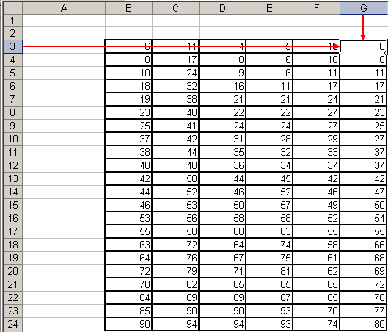
=VLOOKUP(MAX(B3:G4)*B6/G3, $C$8:$F$20, 3, FALSE)
=VLOOKUP(17*B6/G3, $C$8:$F$20, 3, FALSE)
=VLOOKUP(17*18/G3, $C$8:$F$20, 3, FALSE)
=VLOOKUP(306/G3, $C$8:$F$20, 3, FALSE)
=VLOOKUP(306/6, $C$8:$F$20, 3, FALSE)

Slide 28
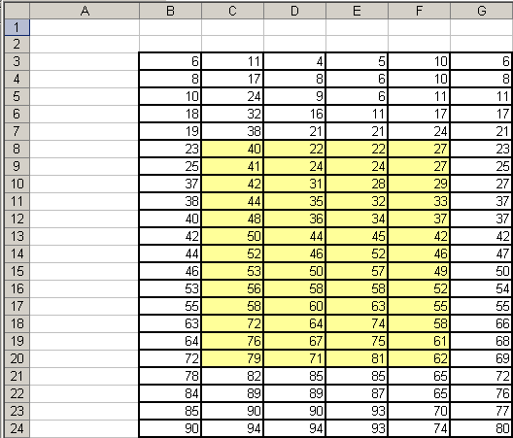
=VLOOKUP(MAX(B3:G4)*B6/G3, $C$8:$F$20, 3, FALSE)
=VLOOKUP(17*B6/G3, $C$8:$F$20, 3, FALSE)
=VLOOKUP(17*18/G3, $C$8:$F$20, 3, FALSE)
=VLOOKUP(306/6, $C$8:$F$20, 3, FALSE)
=VLOOKUP(51, $C$8:$F$20, 3, FALSE)

Slide 29
=VLOOKUP(MAX(B3:G4)*B6/G3, $C$8:$F$20, 3, FALSE)
=VLOOKUP(17*B6/G3, $C$8:$F$20, 3, FALSE)
=VLOOKUP(17*18/G3, $C$8:$F$20, 3, FALSE)
=VLOOKUP(306/6, $C$8:$F$20, 3, FALSE)
=VLOOKUP(51, $C$8:$F$20, 3, FALSE)
=#N/A

Slide 30
(4) =VLOOKUP(C3*E3, C8:F20, IF(SUM(B3:B24)>SUM(F3:F24), 2, 4))

Slide 31
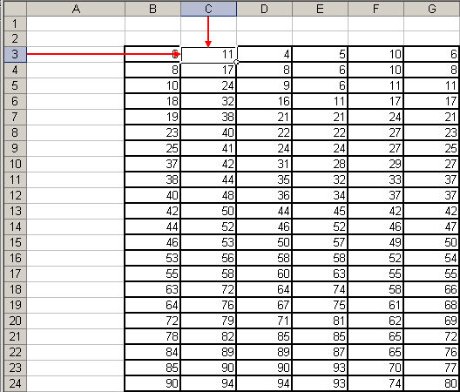
=VLOOKUP(C3*E3, C8:F20, IF(SUM(B3:B24)>SUM(F3:F24), 2, 4))
=VLOOKUP(11*E3, C8:F20, IF(SUM(B3:B24)>SUM(F3:F24), 2, 4))

Slide 32
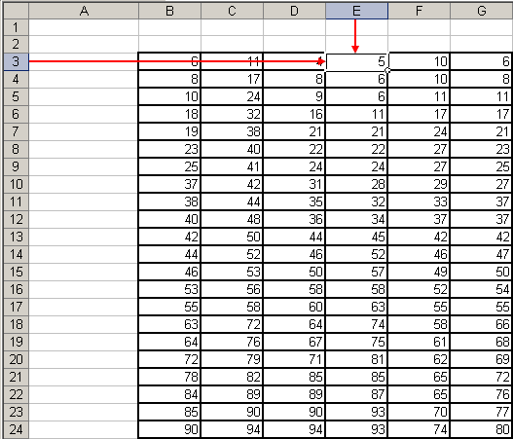
=VLOOKUP(C3*E3, C8:F20, IF(SUM(B3:B24)>SUM(F3:F24), 2, 4))
=VLOOKUP(11*E3, C8:F20, IF(SUM(B3:B24)>SUM(F3:F24), 2, 4))
=VLOOKUP(11*5, C8:F20, IF(SUM(B3:B24)>SUM(F3:F24), 2, 4))

Slide 33
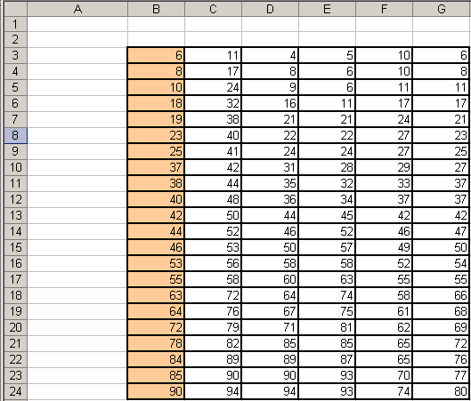
=VLOOKUP(C3*E3, C8:F20, IF(SUM(B3:B24)>SUM(F3:F24), 2, 4))
=VLOOKUP(11*E3, C8:F20, IF(SUM(B3:B24)>SUM(F3:F24), 2, 4))
=VLOOKUP(11*5, C8:F20, IF(SUM(B3:B24)>SUM(F3:F24), 2, 4))
=VLOOKUP(55, C8:F20, IF(1000>SUM(F3:F24), 2, 4))

Slide 34
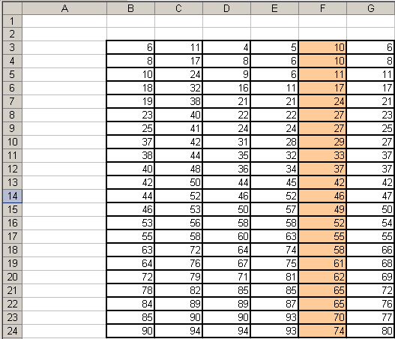
=VLOOKUP(C3*E3, C8:F20, IF(SUM(B3:B24)>SUM(F3:F24), 2, 4))
=VLOOKUP(11*E3, C8:F20, IF(SUM(B3:B24)>SUM(F3:F24), 2, 4))
=VLOOKUP(11*5, C8:F20, IF(SUM(B3:B24)>SUM(F3:F24), 2, 4))
=VLOOKUP(55, C8:F20, IF(1000>SUM(F3:F24), 2, 4))
=VLOOKUP(55, C8:F20, IF(1000>924, 2, 4))

Slide 35
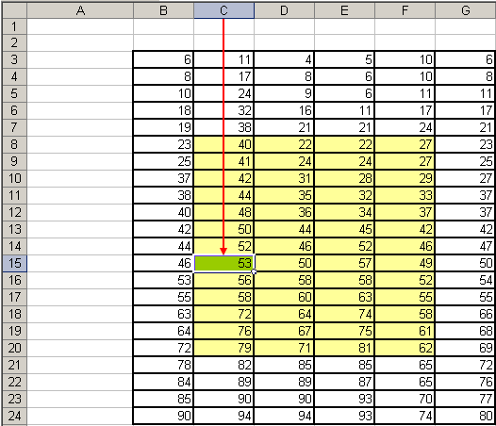
=VLOOKUP(C3*E3, C8:F20, IF(SUM(B3:B24)>SUM(F3:F24), 2, 4))
=VLOOKUP(11*E3, C8:F20, IF(SUM(B3:B24)>SUM(F3:F24), 2, 4))
=VLOOKUP(11*5, C8:F20, IF(SUM(B3:B24)>SUM(F3:F24), 2, 4))
=VLOOKUP(55, C8:F20, IF(1000>SUM(F3:F24), 2, 4))
=VLOOKUP(55, C8:F20, IF(1000>924, 2, 4))
=VLOOKUP(55, C8:F20, IF(TRUE, 2, 4))
=VLOOKUP(55, C8:F20, 2)

Slide 36
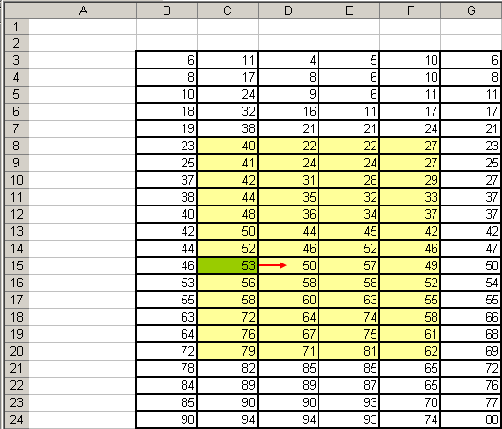
=VLOOKUP(C3*E3, C8:F20, IF(SUM(B3:B24)>SUM(F3:F24), 2, 4))
=VLOOKUP(11*E3, C8:F20, IF(SUM(B3:B24)>SUM(F3:F24), 2, 4))
=VLOOKUP(11*5, C8:F20, IF(SUM(B3:B24)>SUM(F3:F24), 2, 4))
=VLOOKUP(55, C8:F20, IF(1000>SUM(F3:F24), 2, 4))
=VLOOKUP(55, C8:F20, IF(1000>924, 2, 4))
=VLOOKUP(55, C8:F20, IF(TRUE, 2, 4))
=VLOOKUP(55, C8:F20, 2)
=50

Slide 37
=VLOOKUP(LARGE(D10:G17,4), $C$8:$F$20, 5, FALSE)

Slide 38
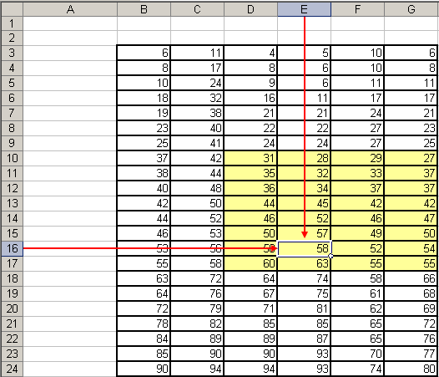
=VLOOKUP(LARGE(D10:G17,4), $C$8:$F$20, 5, FALSE)
=VLOOKUP(58, $C$8:$F$20, 5, FALSE)

Slide 39
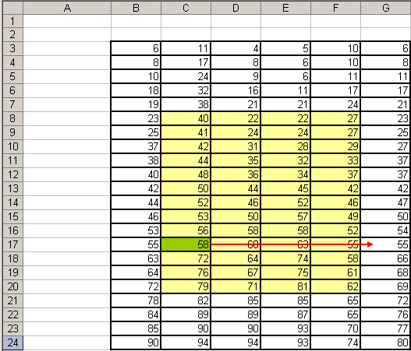
=VLOOKUP(LARGE(D10:G17,4), $C$8:$F$20, 5, FALSE)
=VLOOKUP(58, $C$8:$F$20, 5, FALSE)
=#REF!

Slide 40
IS Functions
(Important for the VLOOKUP Function)
ISNA
  ISNA(value)
  Returns TRUE if value refers to a #N/A error value
Uses
  You can use an IS function to get information about a value before performing a calculation or other action with it. For example, you can use the ISNA function in conjunction with the IF function to perform a different action if an error occurs
  =IF(ISNA(A1), "A #N/A error occurred.", A1*2)
    This formula checks to see if a #N/A error value exists in A1.
    If so, the IF function returns the message "A #N/A error occurred."
    If no #N/A error exists, the IF function performs the calculation A1*2.

Slide 41
ISNA
(VLOOKUP Example)
=IF(ISNA(VLOOKUP(51, $C$8:$F$20, 3, FALSE)),”The lookup value was not found.”, VLOOKUP(51, $C$8:$F$20, 3, FALSE))
The lookup value was not found.

Slide 42
IS Functions
(Important for the VLOOKUP Function)
ISERROR
  ISERROR(value)
  Returns TRUE if value refers to any error value (#N/A, #VALUE!, #REF!, #DIV/0!, #NUM!, #NAME?, or #NULL!)
Uses
  You can use an IS function to get information about a value before performing a calculation or other action with it. For example, you can use the ISERROR function in conjunction with the IF function to perform a different action if an error occurs
  =IF(ISERROR(A1), “An error has occurred.", A1*2)
    This formula checks to see if any error value exists in A1.
    If so, the IF function returns the message "An error has occurred."
    If no error exists, the IF function performs the calculation A1*2.

Slide 43
ISERROR
(VLOOKUP Example)
=IF(ISERROR(VLOOKUP(51, $C$8:$F$20, 3, FALSE)),”An error occurred.”, VLOOKUP(51, $C$8:$F$20, 3, FALSE))
An error occurred.

Slide 44
HLOOKUP Function
Searches for a value in the first row of a table, and then returns a value in the same column from a row you specify in the table.
Syntax
HLOOKUP(lookup_value,lookup_range,row_num,match_type)
Remarks
Use HLOOKUP when your comparison values are located in a row above the data you want to find
The H in HLOOKUP stands for “Horizontal“
Works the same way as VLOOKUP
  Just know the difference between VLOOKUP and HLOOKUP

Slide 45
LOOKUP Function
Another useful lookup function
  To avoid any confusion, I will not present the details of the LOOKUP function at this point
  Instead, I want you to focus on the VLOOKUP function
  Once you fully understand the VLOOKUP function then you should visit the LOOKUP function

